Slide 1
How to Create an Area Chart in Microsoft Excel

Slide 2
Type the data and format it to your liking.

Slide 3
Select Information and Click Insert
Look under the Charts section and select Area

Slide 4
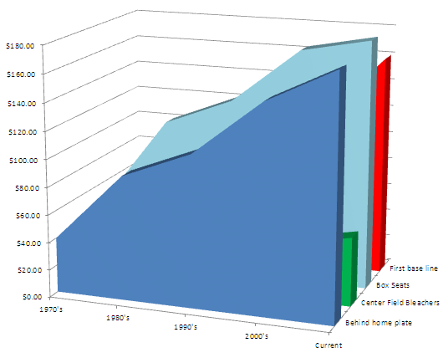
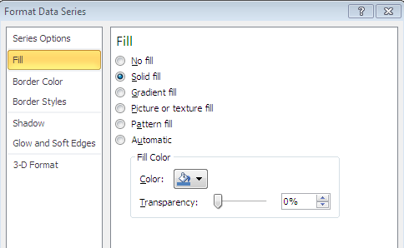
Pick out a chart type and select it.
You will notice that it’s difficult to read the data.
To correct this, double click on one of the data slopes to bring up this window.

Slide 5
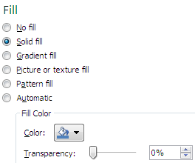
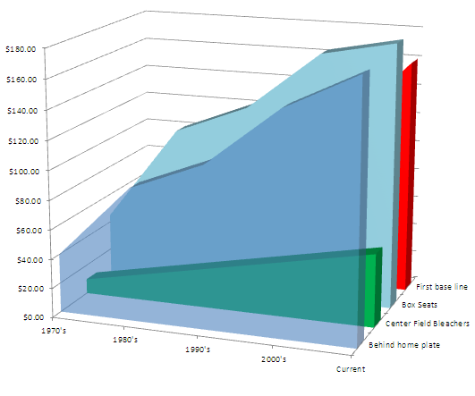
Select the Fill tab and click on Solid Fill.
Now select the color you want and drag the Transparency slider to about 40%.
You don’t want the graph to be too transparent, but you also want to be able to view the other data.
We found that 40% was the best for viewing data.
Repeat this process for each slope.

Slide 6
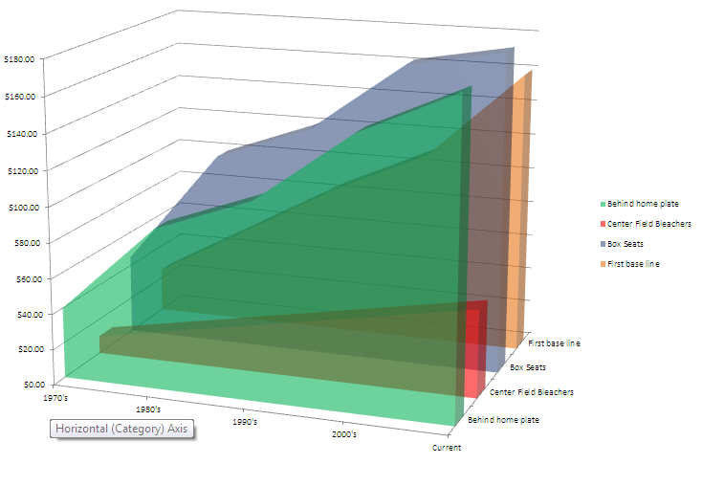
Your data should now be readable.
You should now make any final adjustments and save your work.

